Slide 1
Customer Segmentation
Using K-means Clustering to find target customers for a new product launch

Slide 2
Objective of the Project
2 datasets: Transactions, Customer details
Answer the following questions:
Which merchant category to focus on for launching a new product?
Identifying and describing the various customer segments from the data.
Which specific customer segment would be targeted for launch of the new product?

Slide 3
Methodology
Cleaned the dataset in R
To find the merchant category:
How many unit of products are sold in each category?
How much revenue is each category generating?
To find customer segments
Relation between their relationship status, work status, gender and age according to the merchant category
K-means clustering to segregate the customers based on Recency, Frequency and Monetary values.

Slide 4
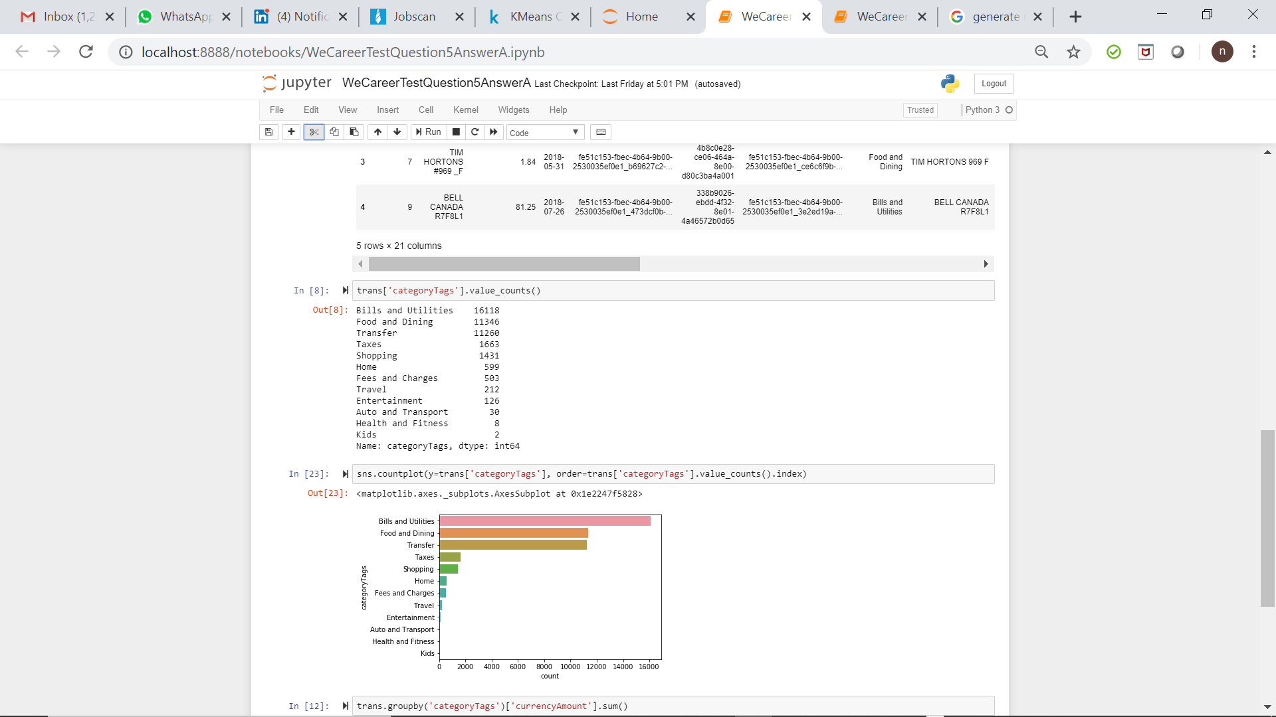
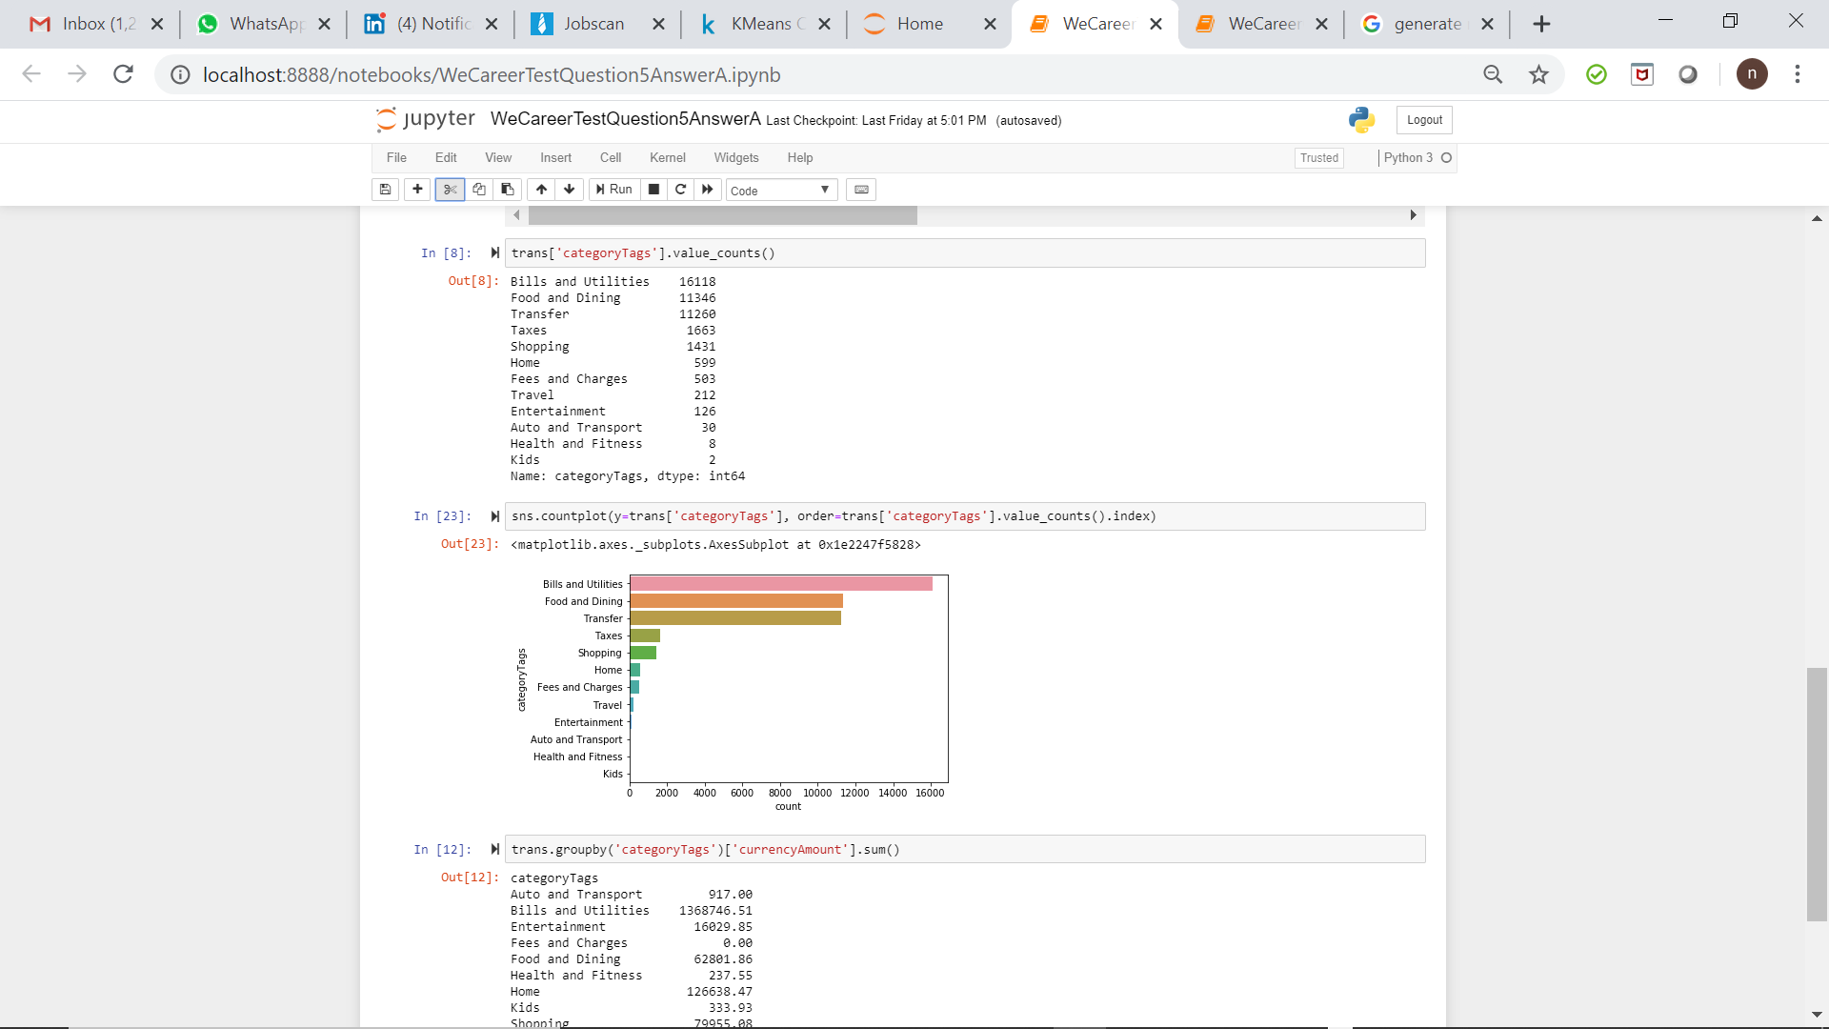
How many unit of products are sold in each category?

Slide 5
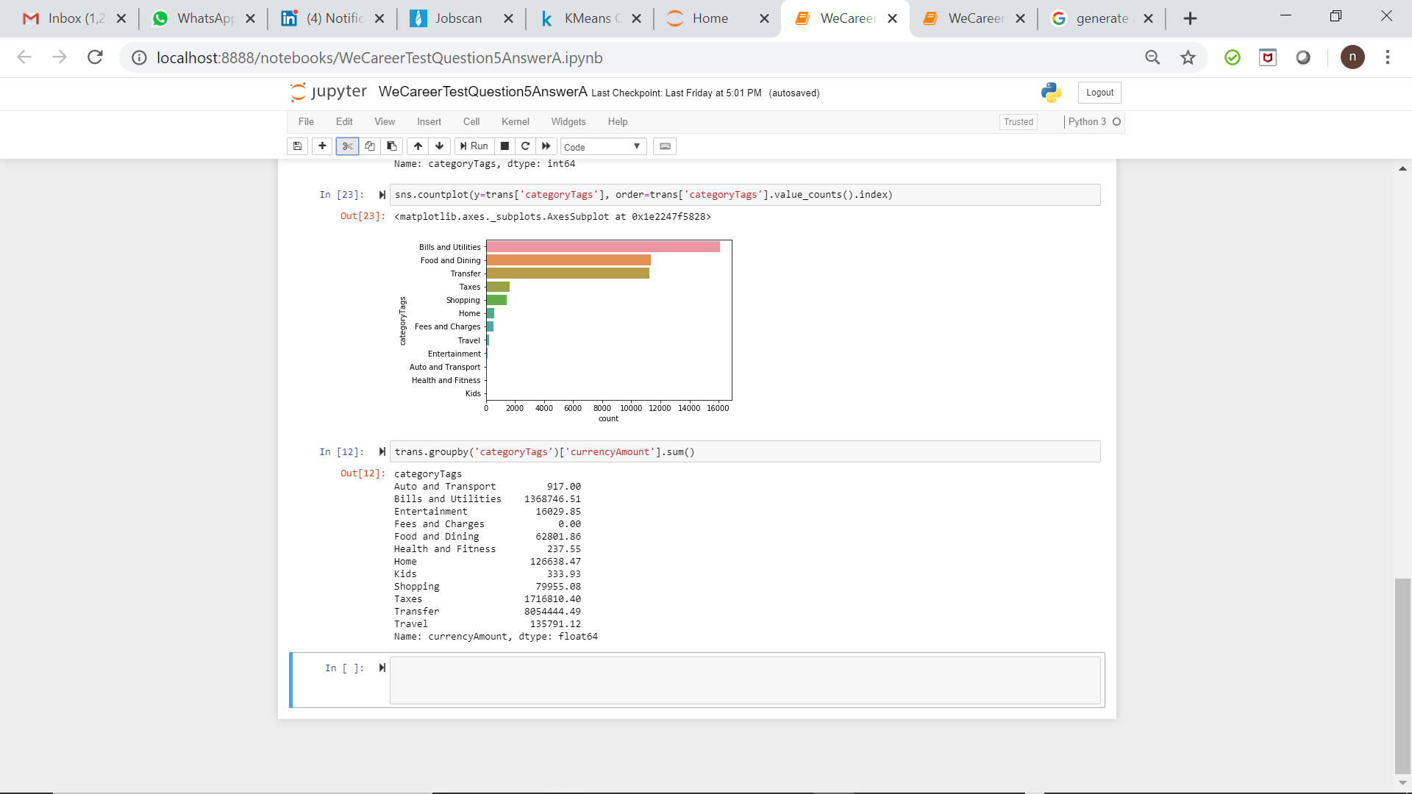
How much revenue is each Category generating?

Slide 6
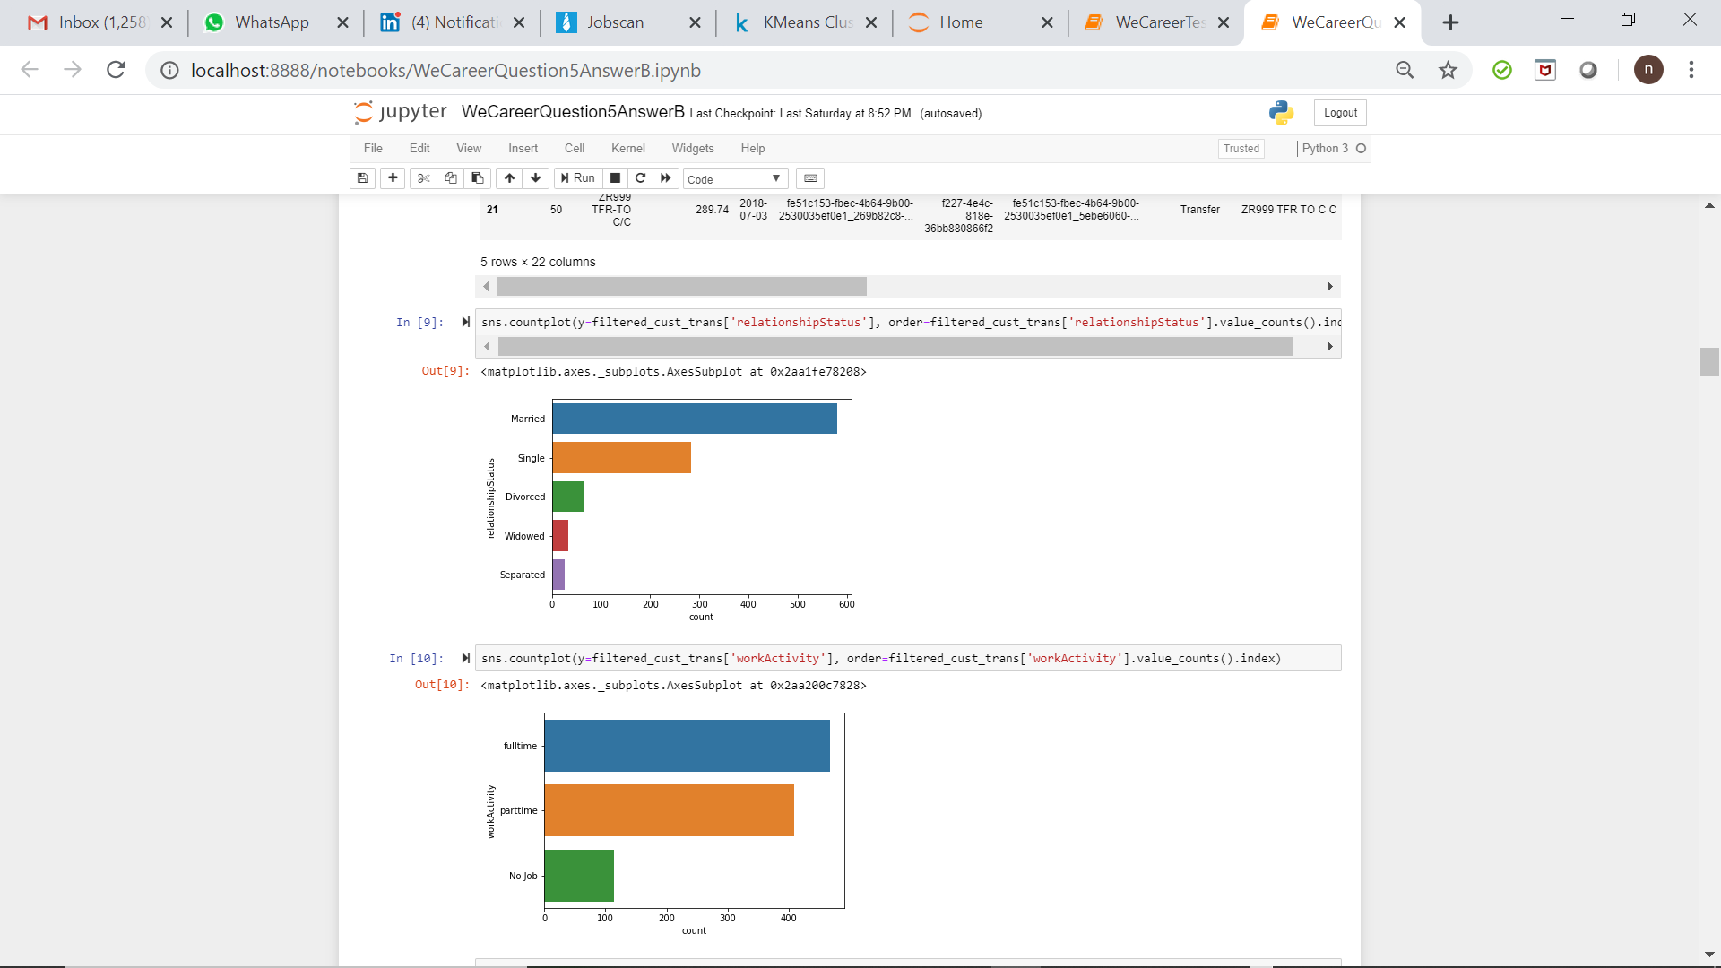
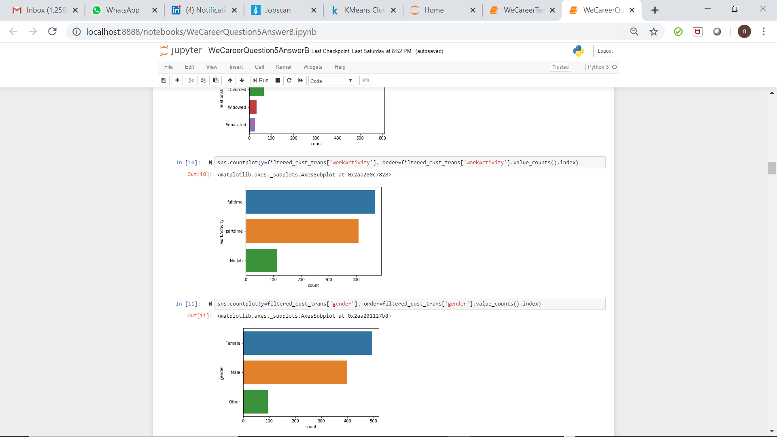
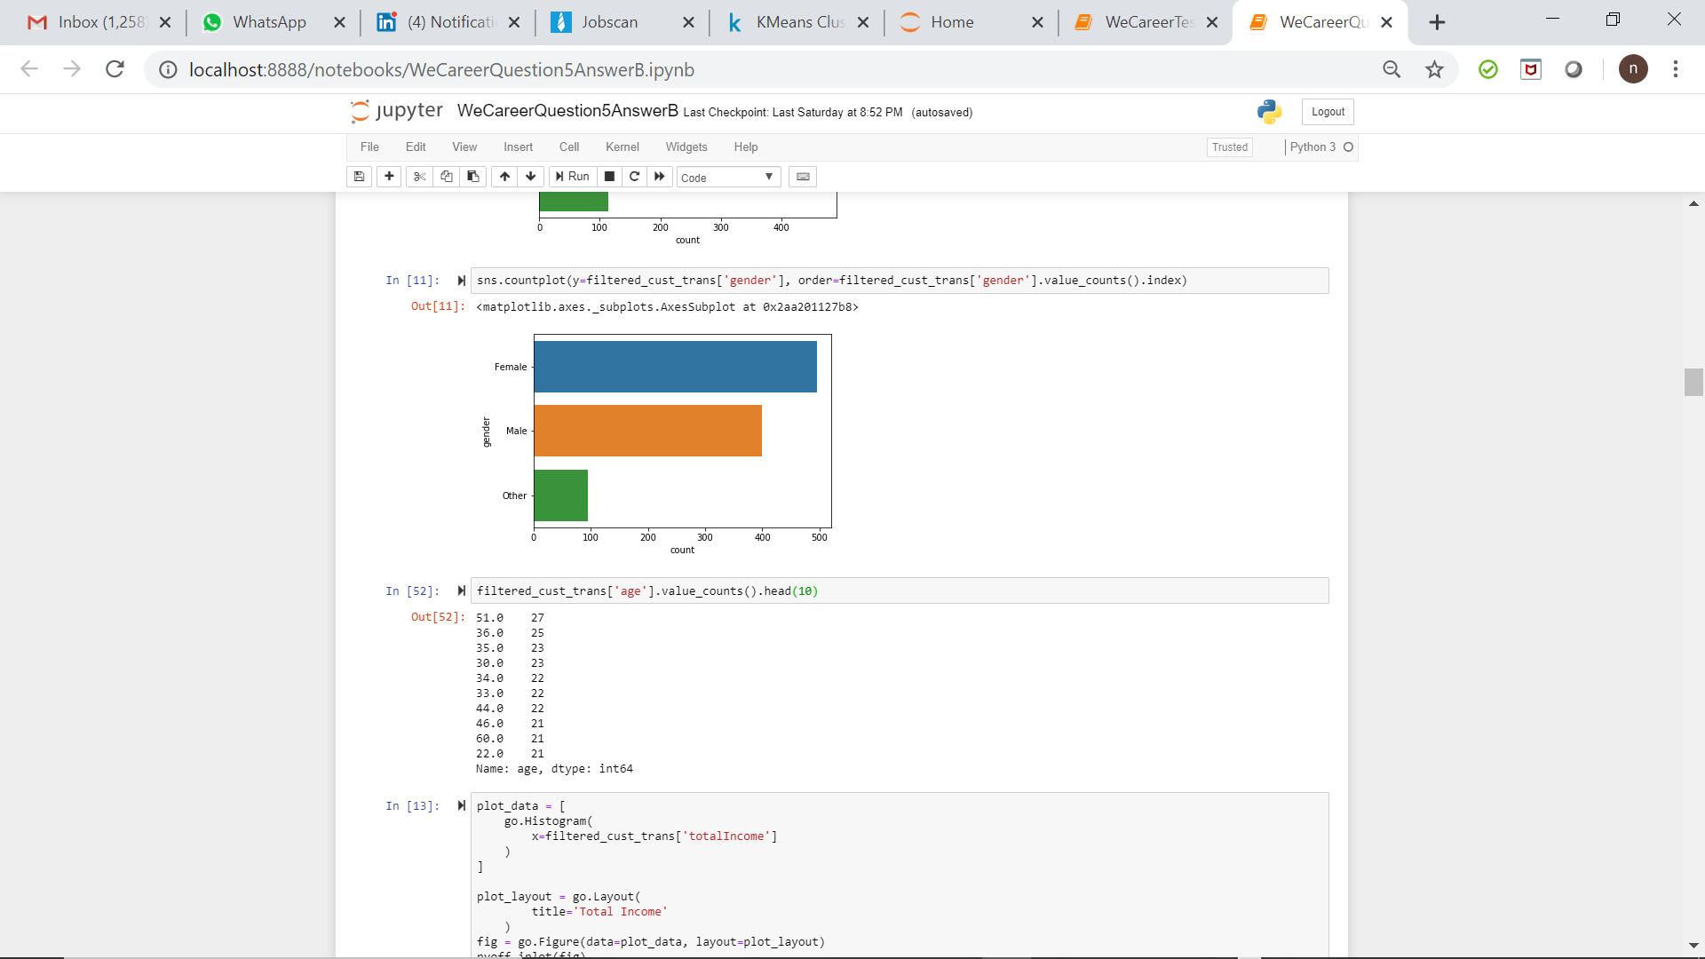
Which specific customer segment would be targeted for launch of the new product?

Slide 7
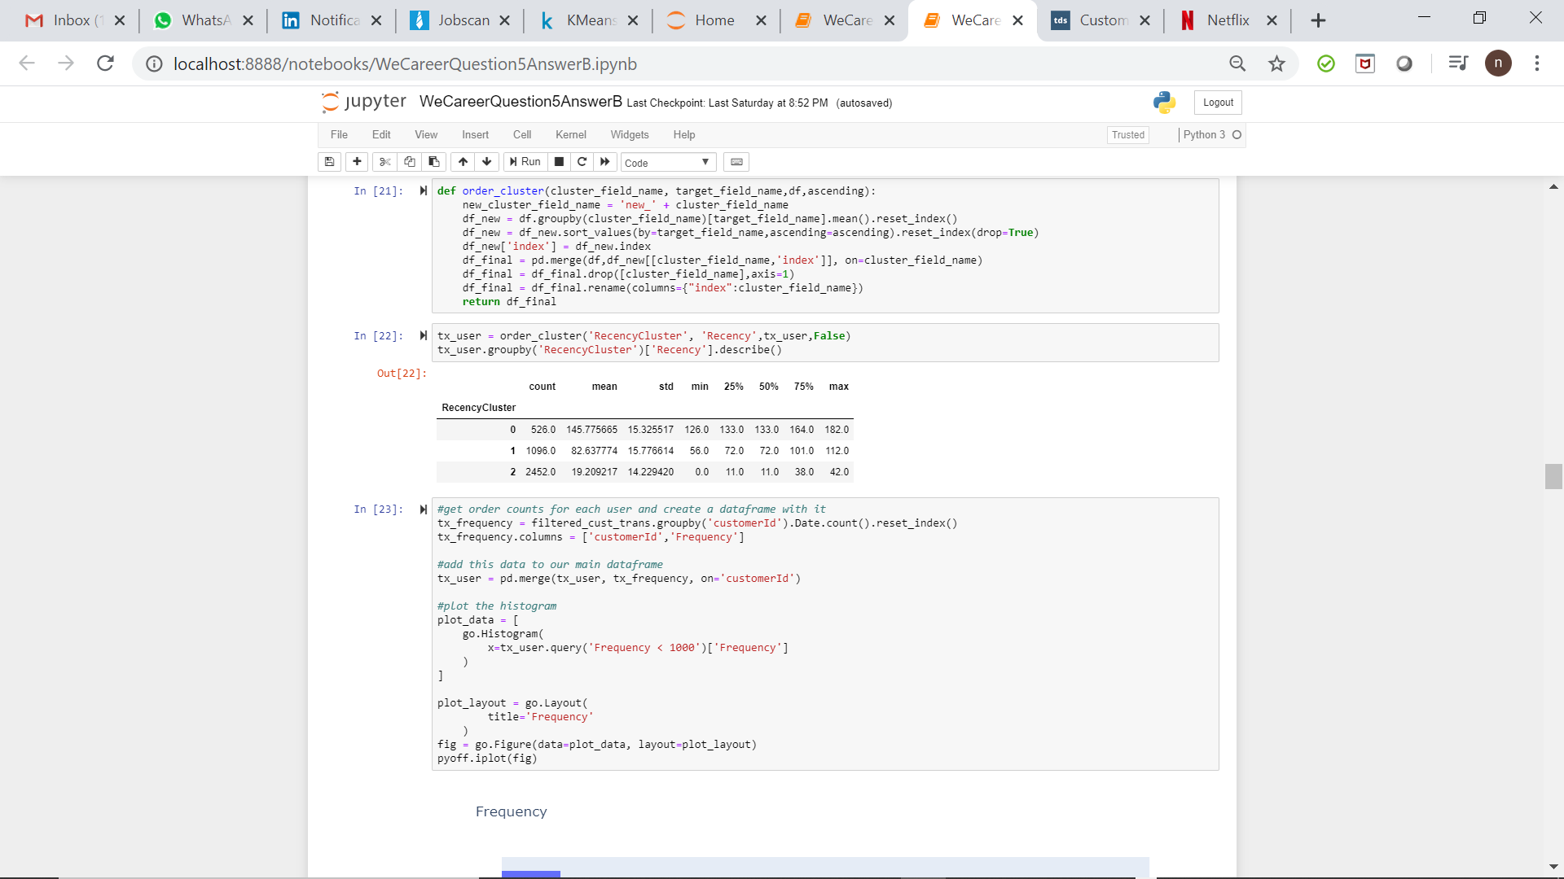
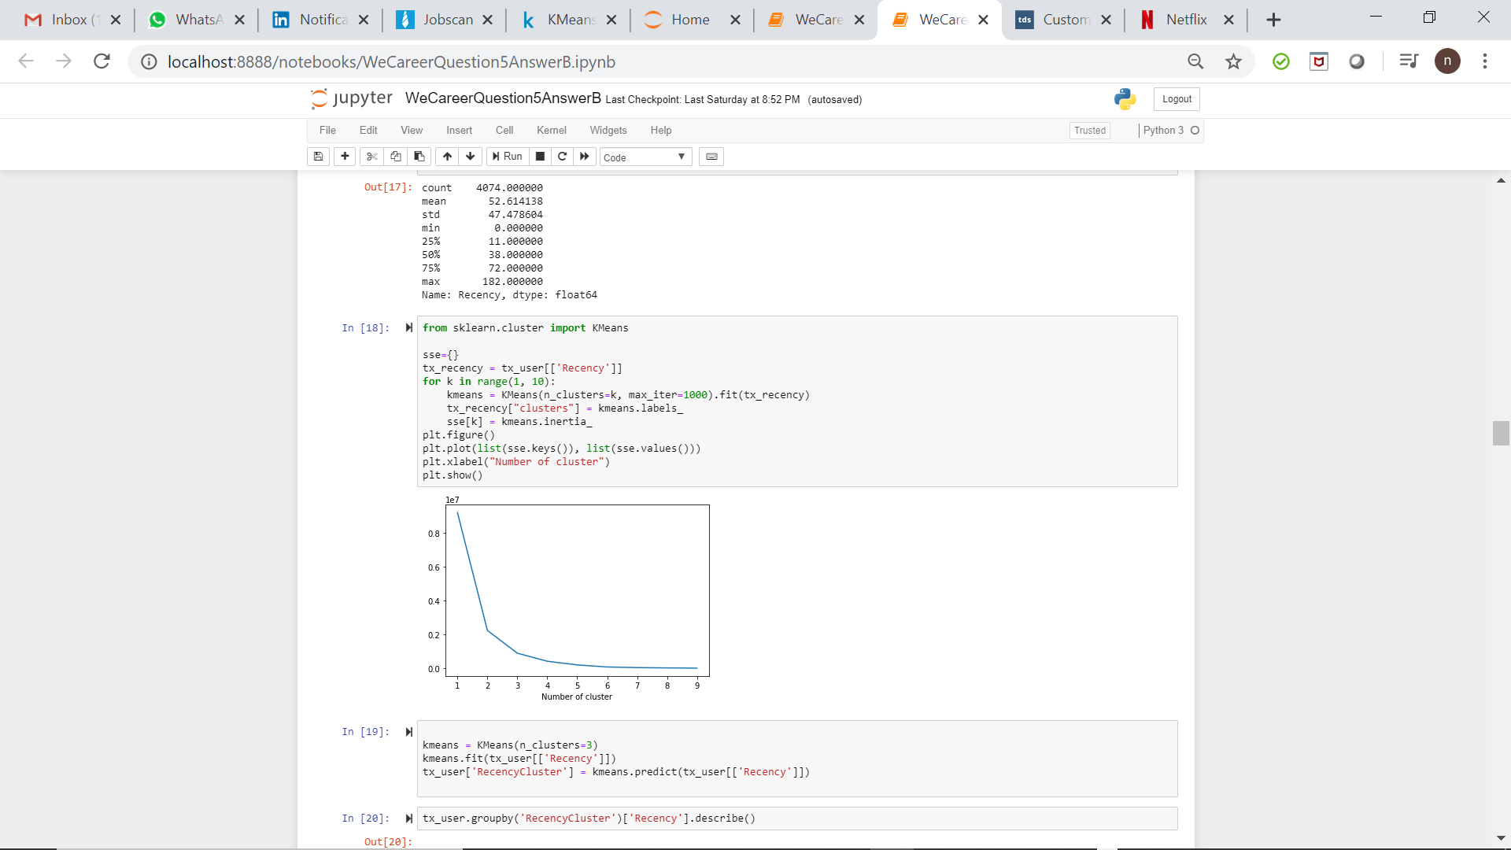
Recency Cluster

Slide 8
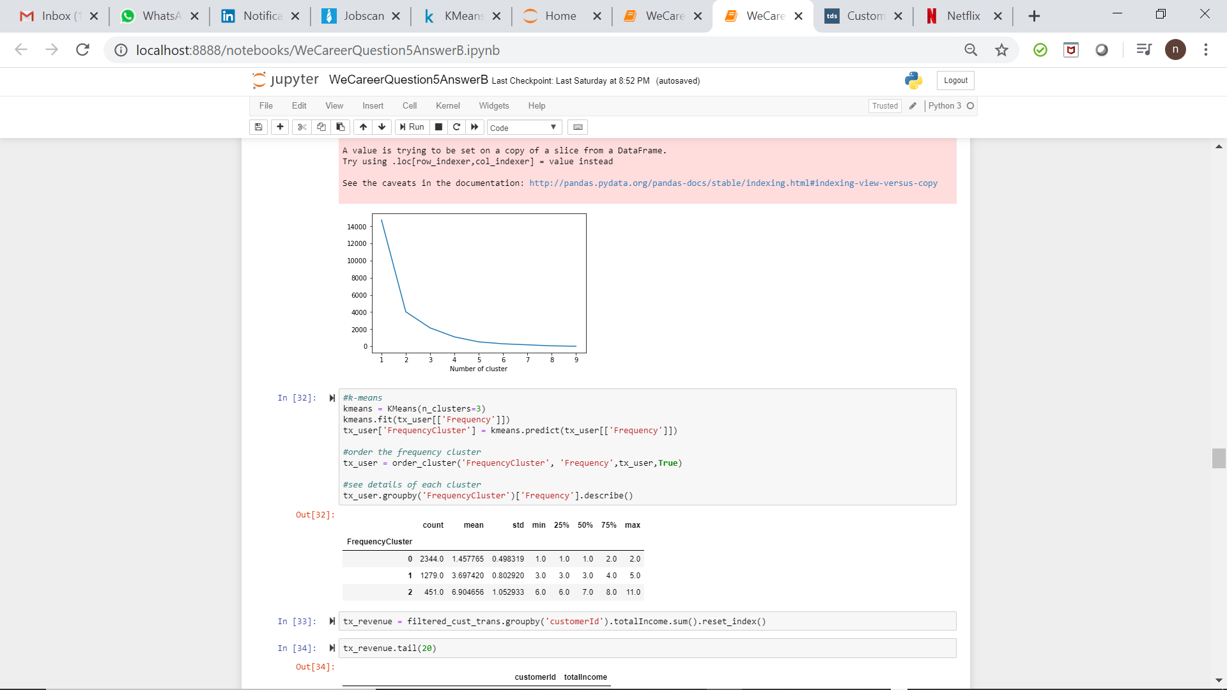
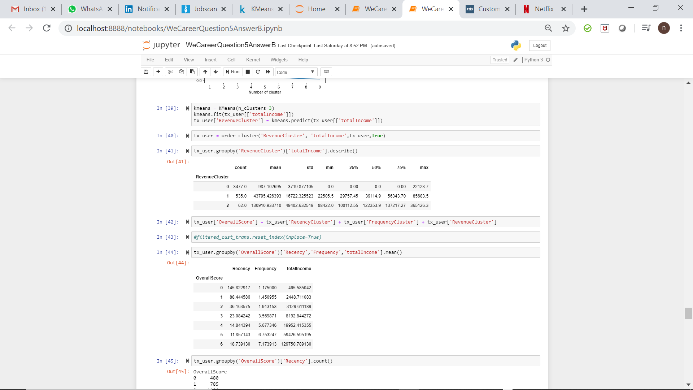
Frequency and Monetary Cluster

Slide 9
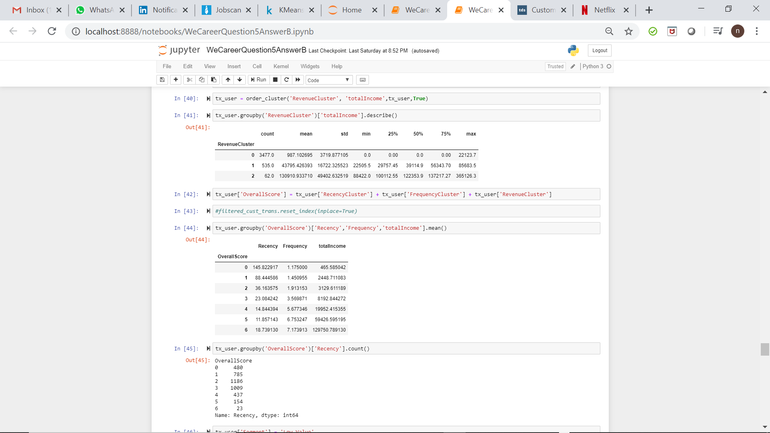
Aggregated Score for RFM

Slide 10
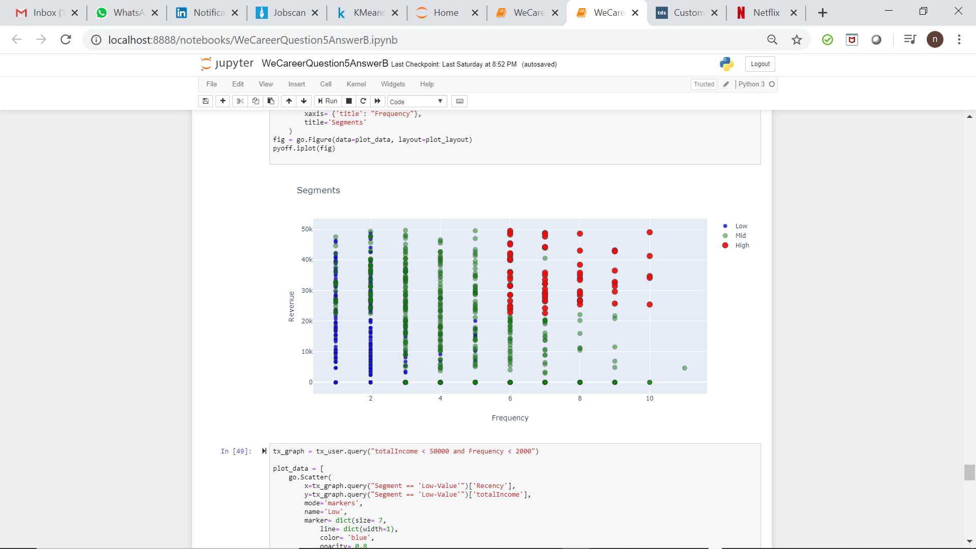
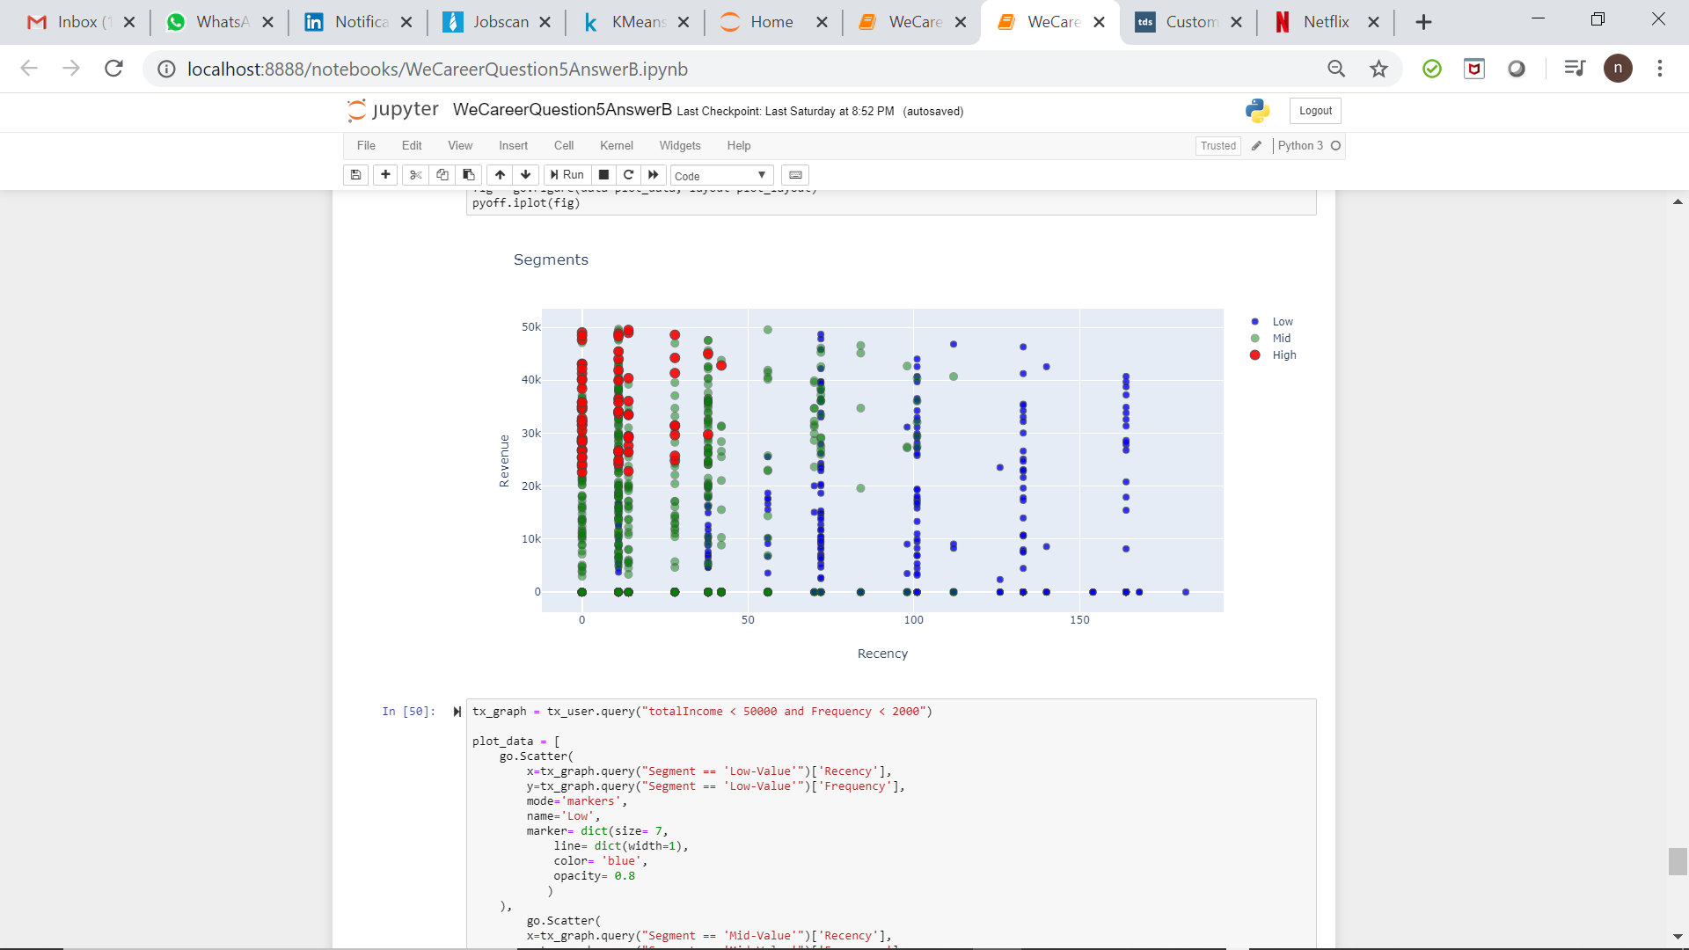
Customer Segmentation Graphs

Slide 11
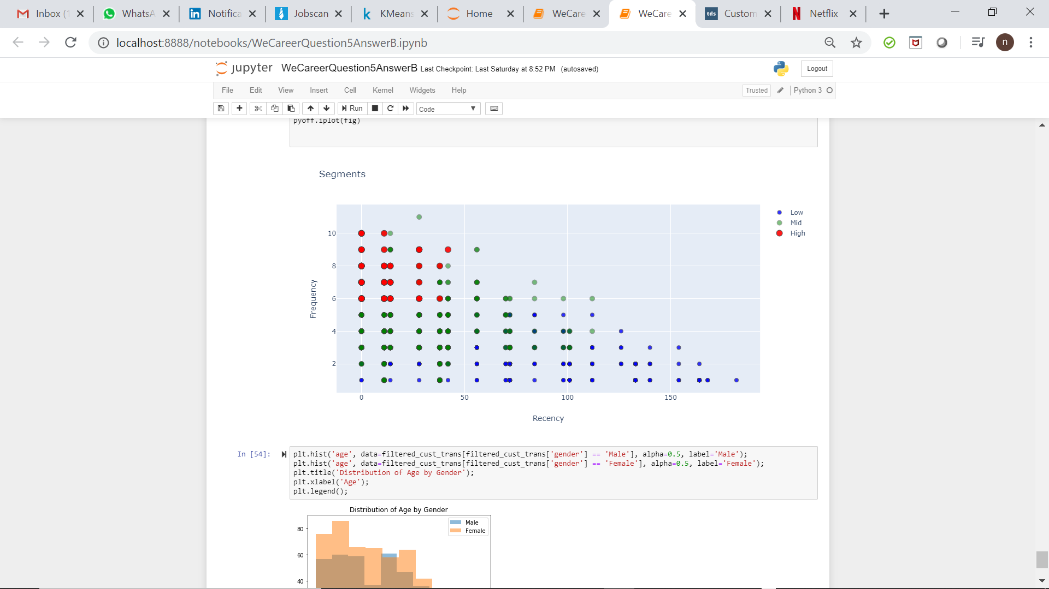
Customer Segmentation Graphs

Slide 12
Recommendation
Launching a product in the transfer category (Credit/Debit Card) will generate maximum revenue
Target customers who are married, working full-time, females
Our high value customers would be customers generating high revenue, are very active (maximum frequency) and very low inactivity

Slide 13
Possible Marketing Strategies
High Value Customers (Low Recency, High Frequency and High Monetary): Promotional efforts to engage the high value customers
It is important to have a long-term learning relationship with these high value customers so there is a valuable dialogue between the customer and the marketing team so that the feedback of each high value customers can be taken into consideration to improve on the product.
Chat bots could be one important way of retaining these high value customers because they provide faster way of communication to the people about the financial services and products.
Mobile marketing is very important because lots of these high value customers do business on their mobile phones. So post the product information on an mobile optimised website of the company. Also, make social media your ally in marketing.

